Slide 1
MY CHART HOW-TO

Slide 2
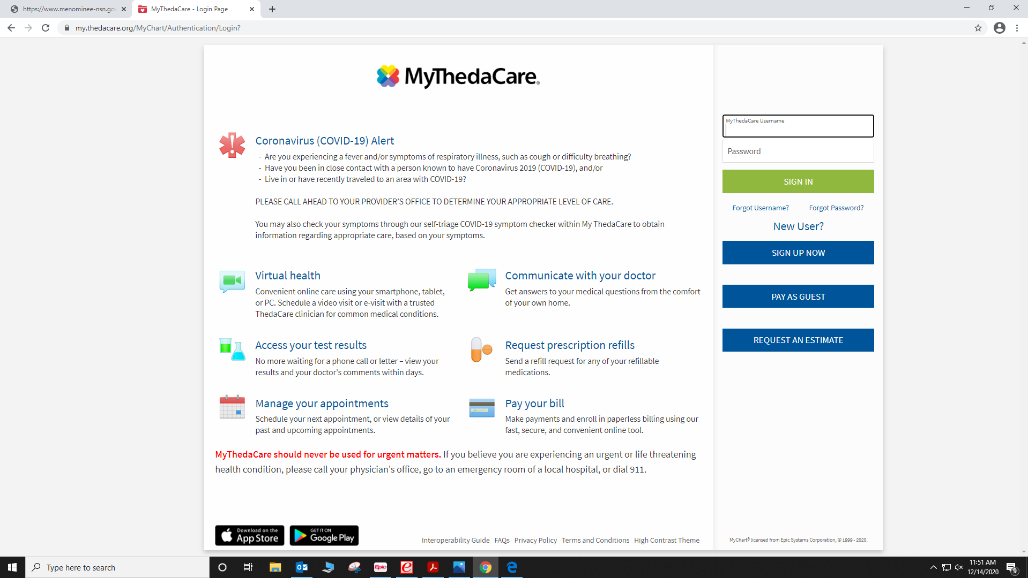
STEP 1: GO TO THIS URL
STEP 2: CLICK “SIGN UP NOW”
NEXT SLIDE

Slide 3
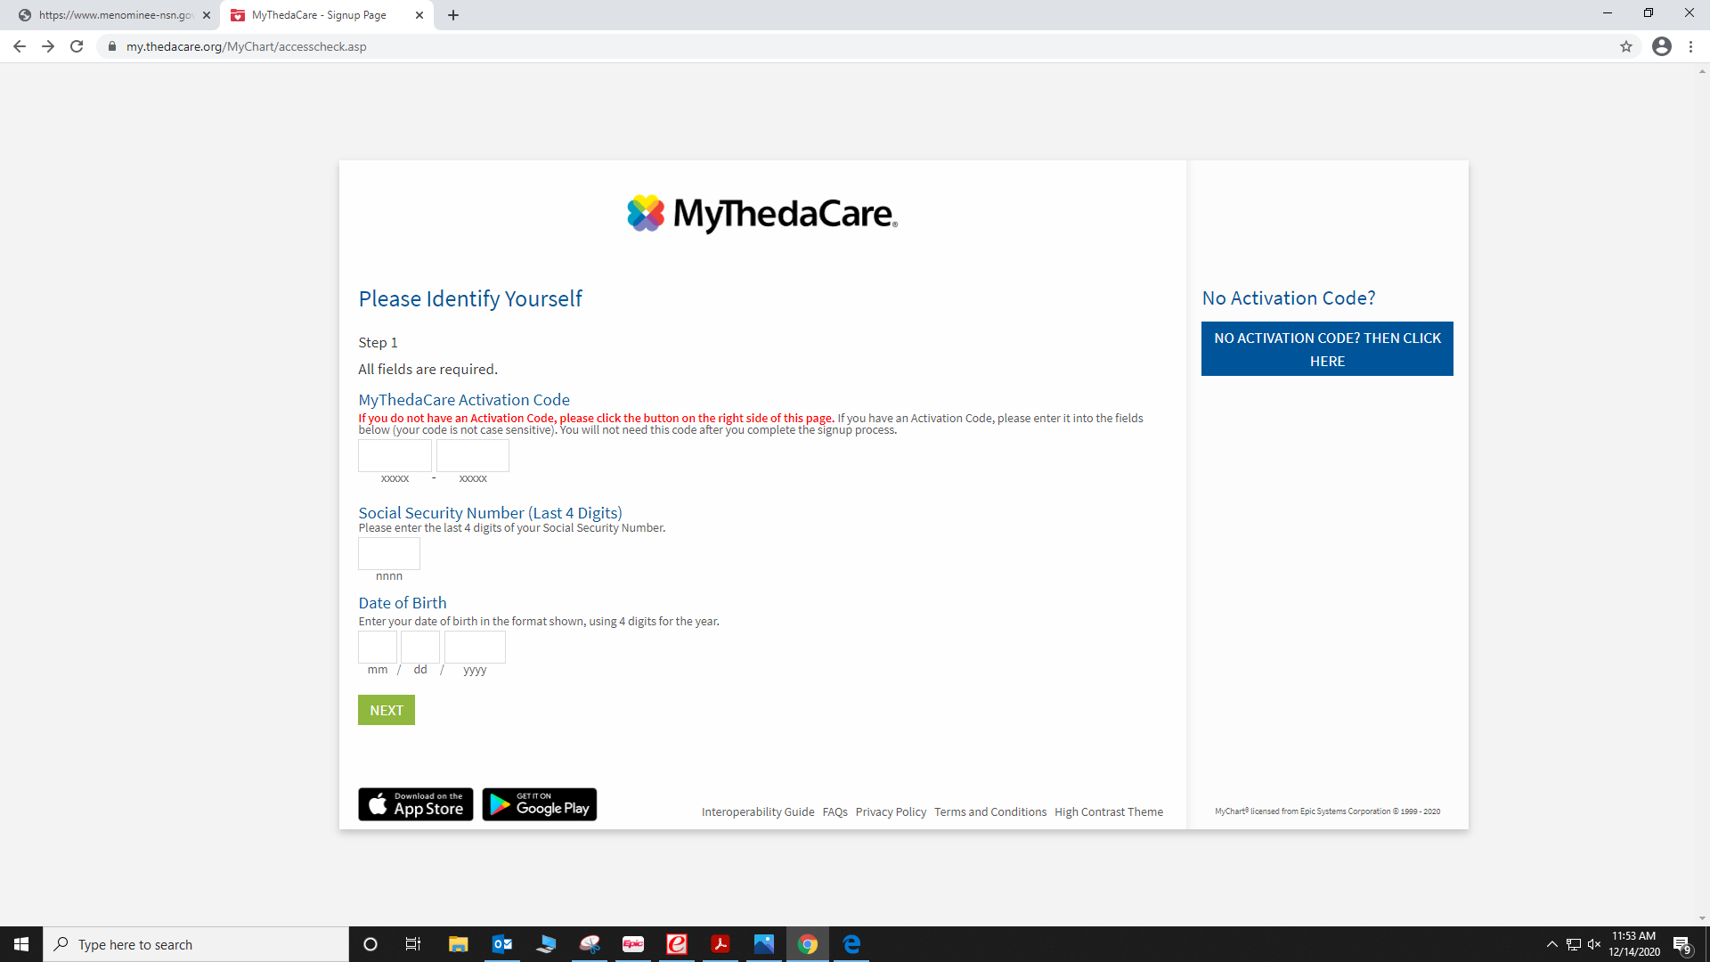
STEP 3: CLICK “NO ACTIVATION CODE? THEN CLICK HERE”
NEXT SLIDE

Slide 4
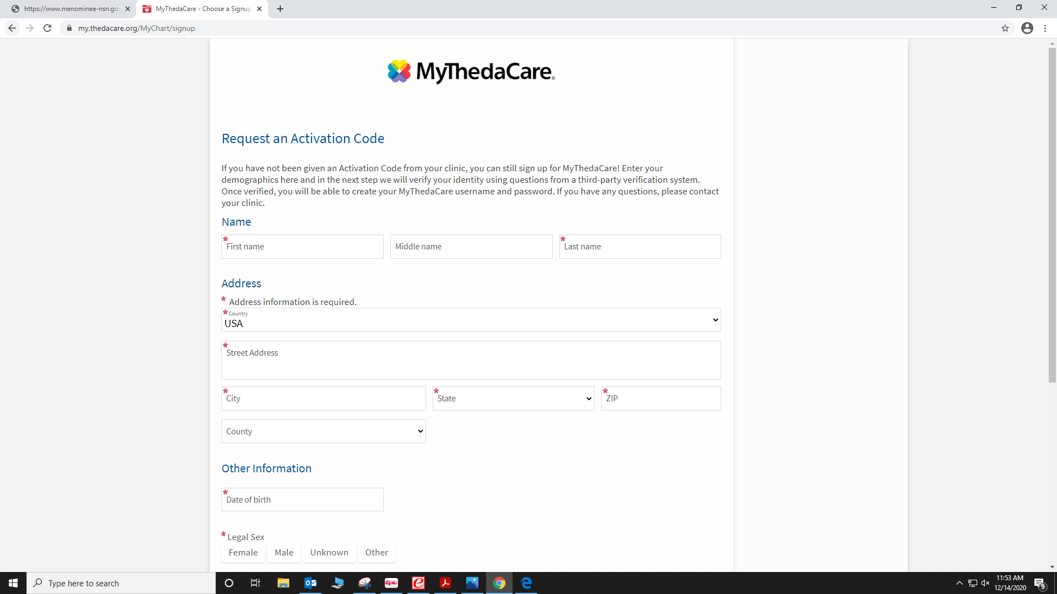
STEP 4: ENTER THE REQUIRED INFORMATION
NEXT SLIDE

Slide 5
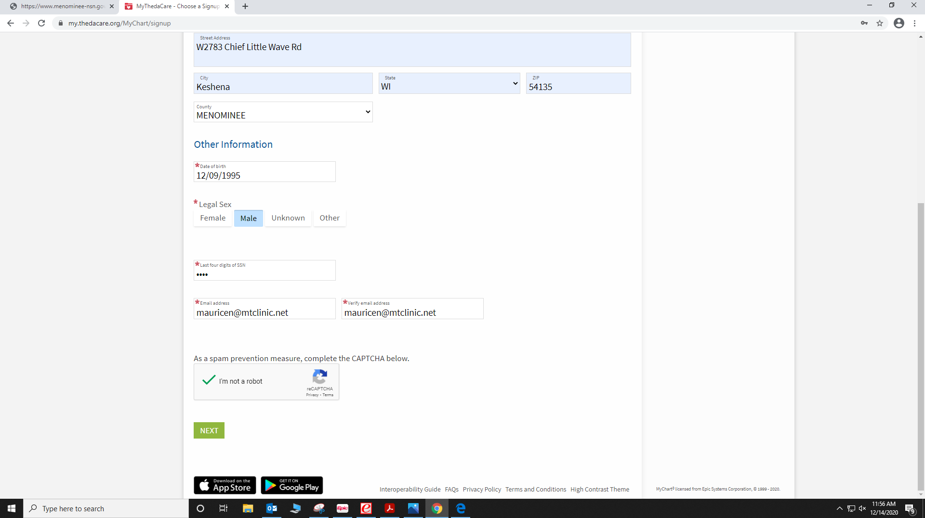
STEP 5: AFTER FILLING OUT ALL REQUIRED INFORMATION
CLICK THE “I AM NOT A ROBOT”
NOT A STEP: PLEASE!!!!!! ENSURE YOU HAVE ACCESS TO THE EMAIL
YOU HAVE LISTED. THIS WILL HELP IF YOU FORGET YOUR LOG IN INFORMATION
STEP 6: CLICK “NEXT”
NEXT SLIDE

Slide 6
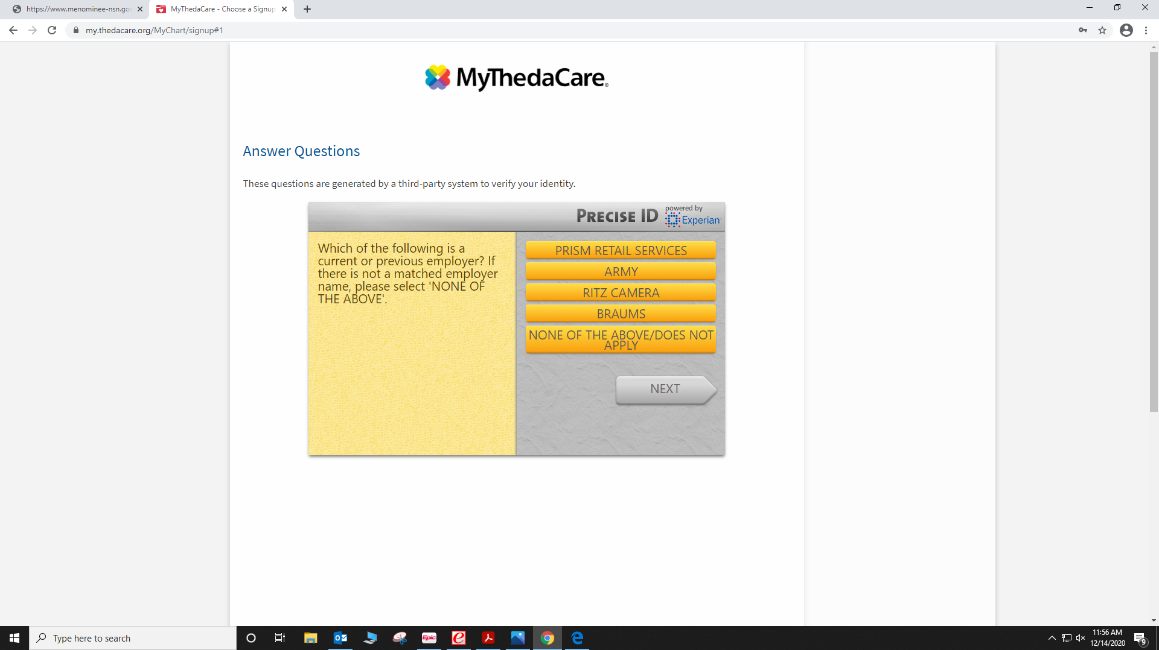
STEP 7: YOU WILL BE ASKED TO ANSWER QUESTIONS ABOUT YOURSELF. ANSWER TO THE BEST OF YOUR ABILITY.
NEXT SLIDE

Slide 7
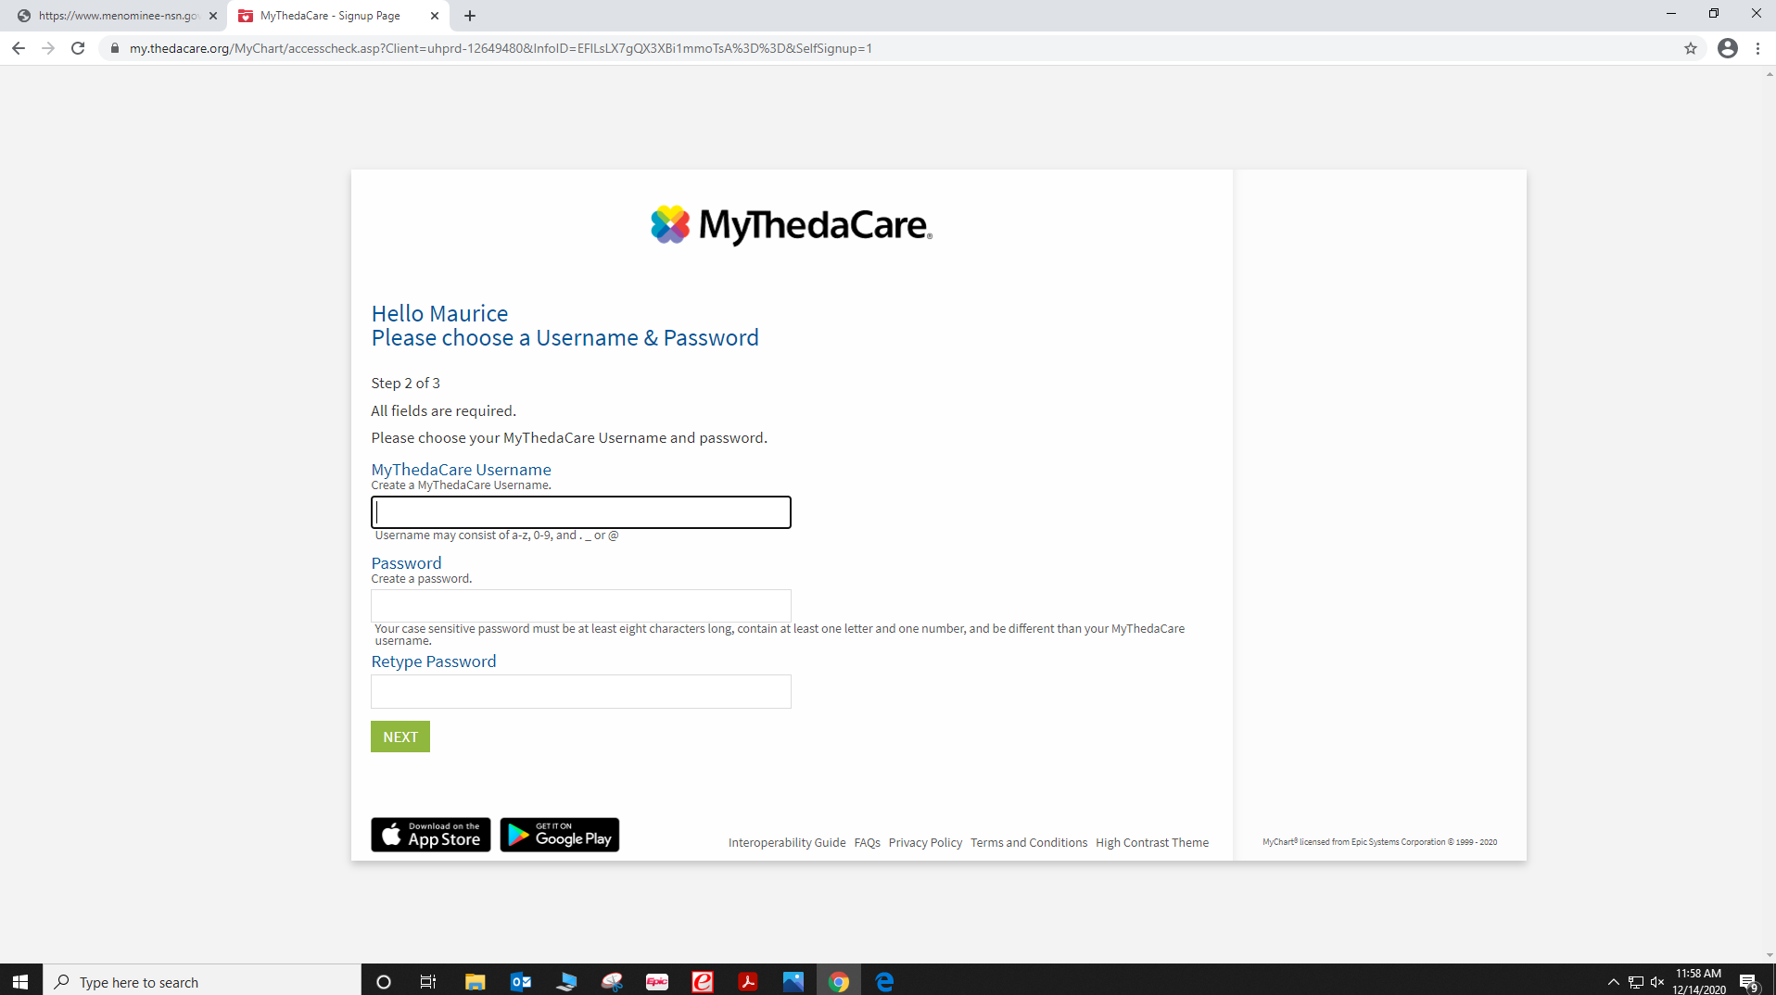
STEP 8: CREATE A USERNAME AND PASSWORD
(PLEASE DO NOT FORGET YOUR PASSWORD!)
STEP 9: HIT “NEXT” AND THEN YOU WILL BE ASKED TO
LOG IN. CLICK “LOG IN”
NEXT SLIDE

Slide 8
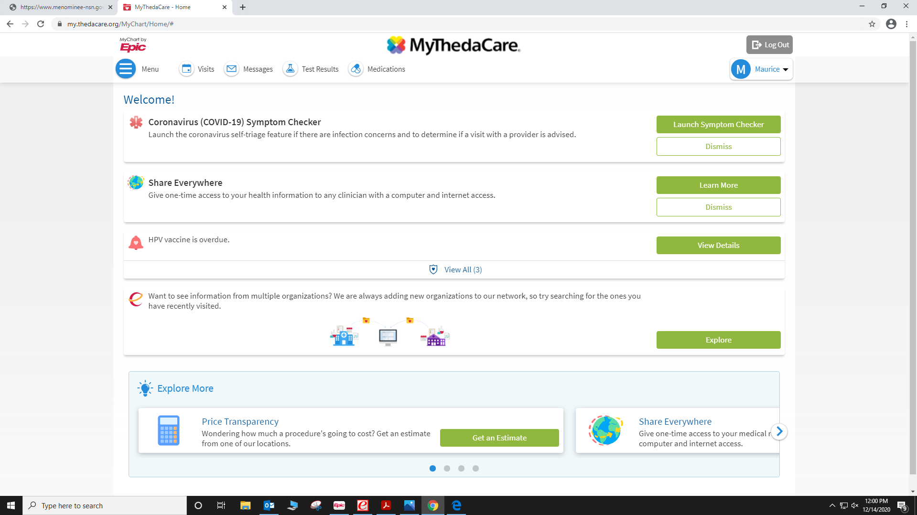
THIS IS HOW YOUR MYCHART WILL LOOK
NEXT SLIDE

Slide 9
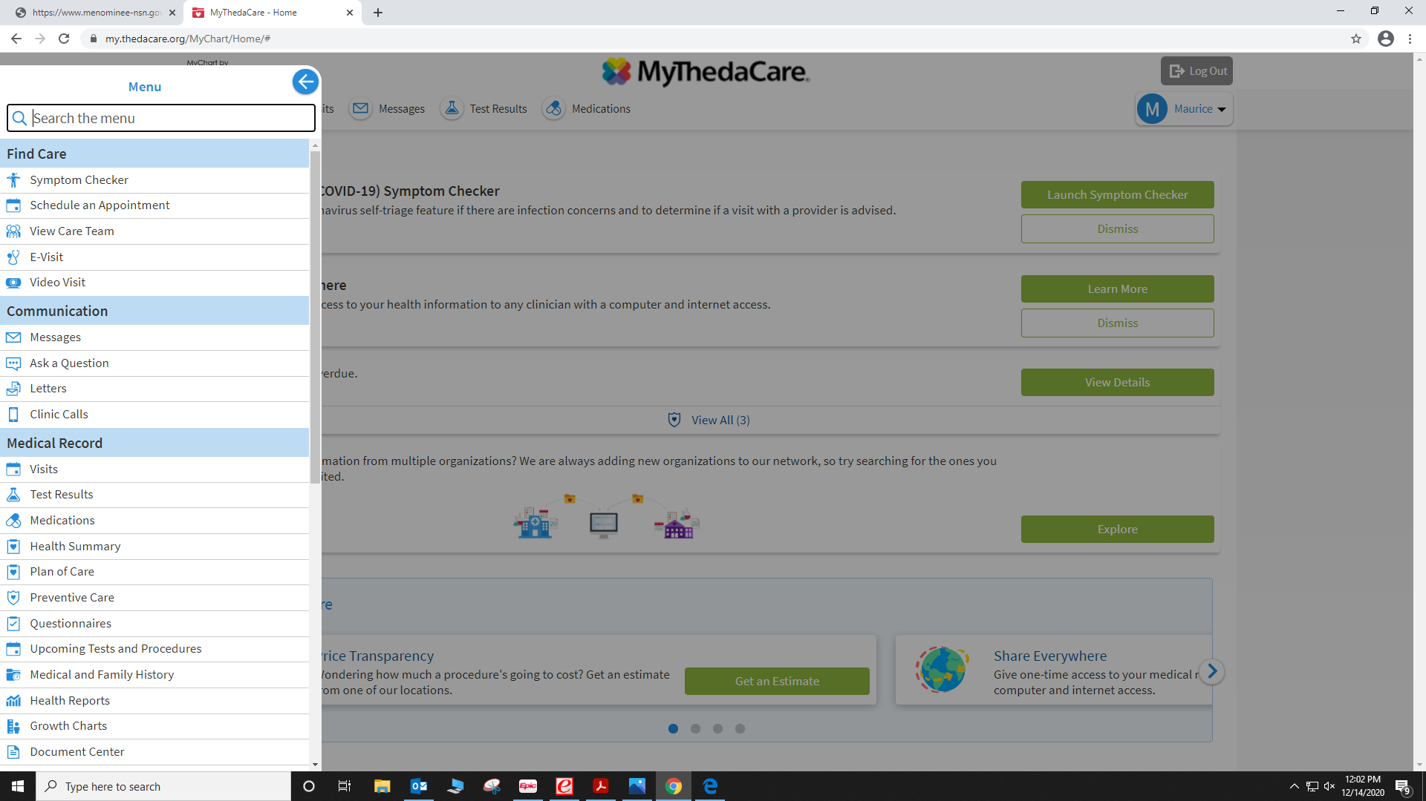
!!!!!YOU NOW HAVE ACCESS TO YOUR “MYCHART”!!!!!

